Slide 1
Introduction to MOT Research Methods
Dr ir Mark de Reuver
November 2023
Notes:
How to design an MOT research project
MOT students often afraid of methods
While methods is fun

Slide 2
Mission of the course
Learn how to design a scientific research project in the area of Management of Technology, and to evaluate its results

Slide 3
What is (business) research?
An organized, systematic, data-driven, critical, objective, scientific inquiry or investigation into a specific problem
Notes:
Discuss the terms

Slide 4
Types of (business) research
Basic / Fundamental | Applied
Generate body of knowledge on class of problems | Solve specific business problem faced by someone in work setting, demanding timely solution
New contribution to scientific knowledge | Apply existing theories to solve a problem
But:
Not mutually exclusive! (e.g. case study, action research)
Both need scientific method such that findings can be relied on as effective solutions
But:
Not mutually exclusive! (e.g. case study, action research)
Both need scientific method such that findings can be relied on as effective solutions

Slide 5
Learning goals: Part 1 (week 1-3)
Create a research design in MOT context
Understand core concepts of research design (theory, population, sample, hypothesis)
Apply the core concepts to design a project (topic → research questions → … → … → selection of analysis methods)

Slide 6
Learning goals: Part 2 (week 4-8)
Critically evaluate the outcomes of a research project in MOT context
Interpret analysis findings
Reflect upon findings / conclusions (validity, reliability, traceability, ethics)
Suggest alternative / future research designs
For qualitative (week 4-5) & quantitative (week 6-8)!

Slide 7
This course vs Thesis Preparation
This course (Y1) | MSc Thesis preparation (Y2)
Foundational knowledge | Prepare for MSc thesis
Detail research design for a given topic | Find the right topic to do a MSc thesis
Design research project in the right way | Designing the right project

Slide 8
Summary: Our mission
Design scientific research in the right way
Interpret and reflect on findings

Slide 9
Course team
Mark de Reuver
Associate Professor
Digital Platforms Design
Ecosystems & Business Models
Data Economy, Digitalization
Qualitative & quantitative methods
Head of ICT Section
Course manager
Lecturer week 1-5

Slide 10
Course team
Mark de Reuver
Course manager
Lecturer week 1-5
Laurens Rook
Lecturer week 6-8
Antragama Abbas
Co-lecturer week 1-5
Teaching assistants
Chatarina Petra Salim
Pavlo Topalli

Slide 11
The empirical cycle
Notes:
How to design an MOT research project
MOT students often afraid of methods
While methods is fun

Slide 12
How to structure a research process?
What are the steps of a research project?
What should be the time order of the steps?

Slide 13
Research process
Initial observation (Research Question)
Data
New theory
Use/modify theory
Identify variables
Generate hypotheses
Measure variables
Collect data to test hypotheses
Graph data
Fit a model
Analyze data
Source (modified): Field, 2009 (p.3)

Slide 14
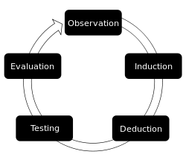
Empirical cycle
Principle of verification = you should find observations in support of your claim and start reasoning from this empirical finding (i.e. to find “truth”) (through induction)
Principle of falsification = a claim remains “true” until proven otherwise (through deduction)

Slide 15
Week 1-3 of this course
Research problem | WHY you’re doing this
Research objective | WHAT you will deliver to solve the problem
Research question | WHAT we need to know to reach the objective
Sub-questions | WHAT we need to know to answer the main question
Approach | HOW you will answer the sub questions
Notes:
Research problem
Research objective
Research question
Research sub-questions
Research approach
Planning
Outline paper / thesis

Slide 16
Research process
Identify (broad) research problem
Literature review
Research objectives, questions, hypotheses
Select research approach / research design
Create plan for research
Sample, instruments, data collection approach
Collect and analyze data
Interpret data and evaluate validity
Communicate findings / write report
Source: Adapted from Gliner et al. (2009), p.20
Notes:
The first step involves identifying the research problem. This initial stage involves choosing a question that has the potential to become a researchable project. Where does the problem come from? From many, especially those in applied disciplines, the problem often comes from a practical situation. Will a particular type of therapy lead to improvement? Will adaptive technology increase communication skills? Will a particular assessment yield effectiveness of assessing students’ learning outcomes? Another place from which research problems may arise is the previous literature. A published study may help to formulate questions leading to a new study.
The second step is to conduct a review or synthesis of the literature relevant to the research problem.
Next the researcher formulate research questions and objectives which further lead to the development of hypotheses. In essence, this involves reducing the research problem to specific research hypotheses that are testable.
The next step is developing a research approach (e.g. randomized experimental) and design that allows the investigator to test the hypotheses. The major focus of the research design is to allow the investigator to control or eliminate variables that are not of direct interest to the study but might affect the results. The design allows the investigator to directly test or answer the research questions.
Next, create a plan for conducing the research, which includes selecting the sample, selecting or developing the instruments, and developing procedures for data collection and analysis. Reliability is the consistency of your measurement, or the degree to which an instrument measures the same way each time it is used under the same condition with the same subjects. In short, it is the repeatability of your measurement. A measure is considered reliable if a person's score on the same test given twice is similar. Validity is the strength of our conclusions, inferences or propositions. More formally, Cook and Campbell (1979) define it as the "best available approximation to the truth or falsity of a given inference, proposition or conclusion." In short, were we right? Let's look at a simple example. Say we are studying the effect of strict attendance policies on class participation. In our case, we saw that class participation did increase after the policy was established. Each type of validity would highlight a different aspect of the relationship between our treatment (strict attendance policy) and our observed outcome (increased class participation). Internal Validity asks if there is a relationship between the program and the outcome we saw, is it a causal relationship? For example, did the attendance policy cause class participation to increase? External validity refers to our ability to generalize the results of our study to other settings. In our example, could we generalize our results to other classrooms?
The next step involves data collection and data analysis. Data collection: unbiased and objective fashion. QDA
The next step involves making inferences or interpretations from the data that are based on statistical analyses related to the hypotheses.
Finally, the findings must be communicated to the profession via a published manuscript or professional presentation.
This example of the research process is in the form of a feedback loop. After the last step, a new research question is asked. If the hypothesis was confirmed, then a new question could be asked toward gaining additional information. If the hypothesis was not confirmed, the new question may be a modification of the original question, or the methodology might be altered or readdress the original question.
Sometimes, in practice, the process can be shorter: e.g. literature/theory → deduce hypotheses → test hypotheses.

Slide 17
What’s new in 2023-2024?

Slide 18
Call to action
Participate in Evasys survey
Better: give us suggestions during the course!

Slide 19
Materials and Examination
Notes:
How to design an MOT research project
MOT students often afraid of methods
While methods is fun

Slide 20


Materials
Software
JASP (quantitative, open source, free)
Atlas TI (qualitative, student version suffices)
Required readings
Week 1-5: Sekaran & Bougie (ed 7 or 8)
Week 4-5: Baxter & Jack (2008)
Week 6-8: Jackson (Statistics)
Lecture slides

Slide 21
Study load
Component | Study load
Lectures (preparing / assignment) | 2 x 8 x (2 + 2) = 64 hours
Studying the book (reading, summarizing, processing) | 320 pages → 45 hours
Studying the slides (reading, summarizing, processing) | 15 slide-packs → 23 hours
Practice exam | 5 hours
Exam | 3 hours
Total study load | 139 hours EC: 5 x 28 = 140 hours

Slide 22
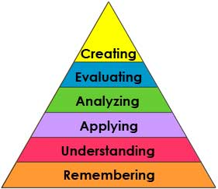
Examination
Assignments
LO 1: Create a research design for MOT
Exam
LO 2: Critically evaluate the outcomes of an MOT project
LO 2c: Suggest alternatives
LO 2b: Reflect upon findings
LO 2a: Interpret findings
LO 1b: Apply core concepts to design a project
LO 1a: Understand core concepts of research design
Note: Need to understand core concepts before you can apply them!

Slide 23
Examination
Weekly assignments (15%)
Week 1-5
Written exam (85%)
Open questions (cases, excerpts)
See Course Information – Assessment specification
See Course Information – Sample questions

Slide 24
Summary
Software, book and slides
Check Brightspace for specifics!
Course load
It’s more than watching a few videos!

Slide 25
Teaching methods Week 1-5

Slide 26
Modules
Module | Topics | Week
1. Basics of research design | Research objective, questions Research ethics | 1-2
2. Conceptual model | Constructs, variables Hypotheses | 2-3
3. Research design | Causality, validity Research strategies
4. Measurement | Measures Validity, reliability | 3-4
5. Sampling | Inferential statistics Sampling, population
6. Case study research | Case study protocol Practices of case research | 4-5
7. Qualitative analysis | Qualitative vs quant Coding | 5

Slide 27
Each module consists of…
Online videos: Instruction
Reading materials (e.g. book)
Lecture: Practice with materials
Assignment (graded)
Lecture: Wrap-up, Q&A

Slide 28
Online videos
Each module has 4-9 online learning videos
Short intro to topics of the module
Not a substitution for reading the book!
Illustrate and give examples

Slide 29
Weekly assignment (week 1-5)
Goals
study and practice early;
experience to design a study;
reflect critically on research designs
Deadline: Thursday 12.00, each week
Evaluation
Rubric: yes/no on multiple criteria
TA reviews, course manager checks
Generic feedback given in live lecture
15% of final grade

Slide 30
Weekly assignment (week 1-5)
ChatGPT
Can generate research questions, hypotheses – but often boring ones
Weekly assignment is to practice – ChatGPT is not available in your exam
Strong advice: Do not use unless instructed to do so (in later weeks)

Slide 31
Lectures (week 1-5)
Tuesday: Practice lecture
Practice with cases, similar to exam
Prepare by watching the online videos of that week
Monday: Wrap-up lecture
Wrap-up of contents of the past week
Prepare by reading the book chapters and completing the assignment
Q&A, quiz, generic feedback

Slide 32
Each module consists of…
Online videos: Instruction
Self-test: Multiple choice questions
Reading materials (e.g. book)
Lecture: Practice with materials
Assignment (graded)
Lecture: Wrap-up, Q&A

Slide 33
If you have questions any time
Use the discussion board!
Students help each other answering questions
TA moderates and can send questions to the lecturers
Guaranteed answer within 2 working days
Avoid non-moderated side-channels

Slide 34
Summary
Prepare lectures
Use Brightspace as a checklist
Online videos
Reading materials
Weekly assignments
Use discussion board
Engage and participate

Slide 35
Weekly assignment topic

Slide 36
Your experience

Slide 37
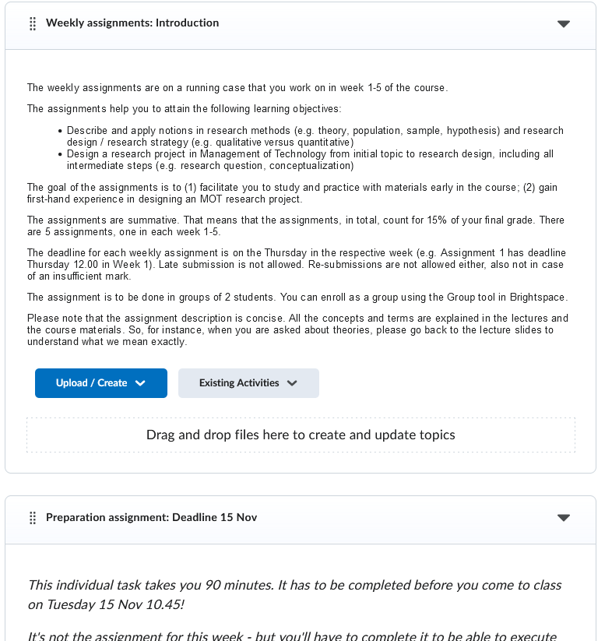

Slide 38
To do before tomorrow 10.45!
See Brightspace – Content – Module 0 – Preparation assignment
Preparation assignment
Define a topic for MOT research based on your prior experience (internship, job)
Describe your experience / problem
Define a problem area for your research
Submit the problem area in the assignment box
Lecture is interactive, based on your submitted idea
Without preparing, you cannot participate in the lecture

